Slide 1
AIST2010 project proposal
A rhythm game by sound control
Cheng Ka Pui (1155125534)
Lam Puy Yin (1155126240)

Slide 2
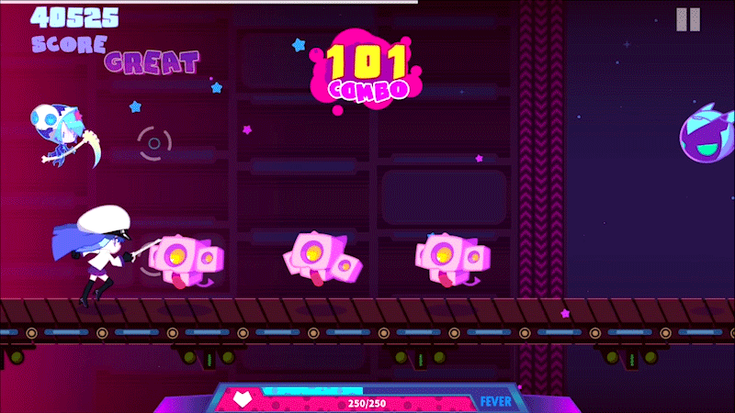
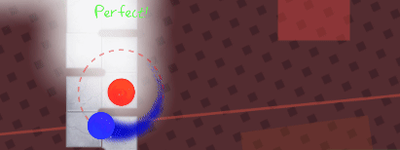
Basic Ideas
A rhythm game that use sound as input (no key or fingers but sound!)
Language: Python (Librosa, Pygame and More!)

Slide 3


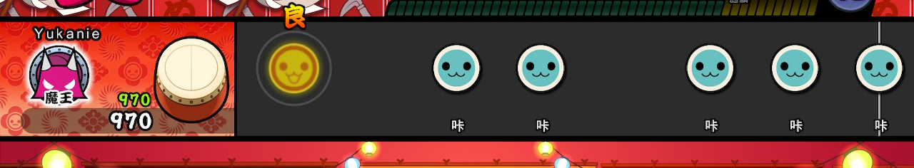
Rhythm Game Concept
Beats to be hit (Prepare the onsets before playing the track)
Move the onsets along the track as music continues
Detecting area : if the onset position is inside the valid range when user make a sound input
Get scores!
Notes:
have basic rythm game concept

Slide 4
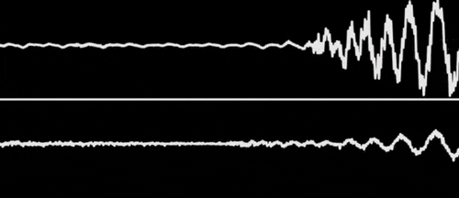
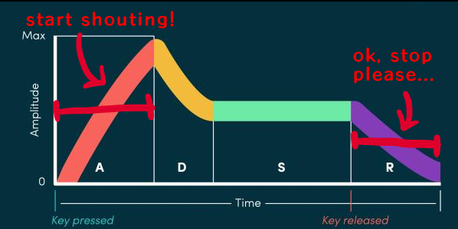
Sound Control
Sound Input Detection (audio recording)
Measure ADSR Envelope for dectecting
the attack and release of
a short note
Notes:
voice contains amplitude data
use envelope to detect an impluse
sent to input and see if it hits the targeted beat

Slide 5
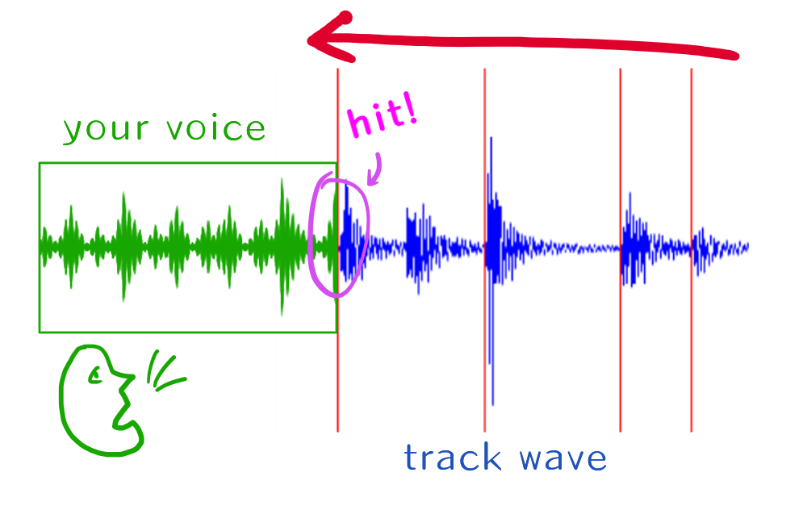
Basic illustration
a
Notes:
two main components
hit or not (purple range = hit detection area)
voice input = an impulse , onset = a beat

Slide 6
Thank you

